Slide 1
Solving Graph Isomorphism with Minimum Bit Strings
Josh Krcadinac
Rafael Lastiri

Slide 2
Overview
What is Graph Isomorphism
Applications
Bit String Background
Our Contribution
Results
Next Steps
Questions

Slide 3
What is Graph Isomorphism
Two graphs are isomorphic if we can find a permutation of the set of edges and vertices of one graph and map them to the edges and vertices of the second graph
Requires the same:
Number of vertices
Number of Edges
Vertex degrees
Graph structure

Slide 4
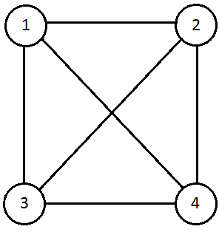
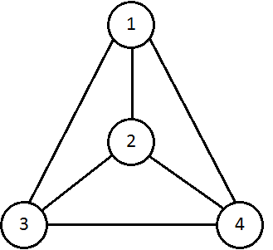
Graph 1
Graph 2

Slide 5
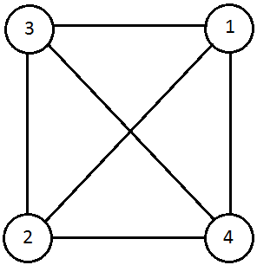
Note: Two graphs can have more than one isomorphism
Graph 2 can map onto Graph 1

Slide 6
Applications
Chemistry
Checking if molecular structures equivalent
Cryptography
Replacing classical S-Box
File Comparison
File similarity
Social network pattern Analysis
Suspicious behavior
Civil Engineering
Looking for desired geographic locations
Notes:
Chemistry – same formula different structure
Crypto – replacing standard sbox with isomorphic equivalent
File comparison – Subgraph isomorphism to tell how similar 2 files are
Social Networks – identify suspicious behaviours
Civil Engineering – look for desired locations

Slide 7
Bit String Background
Make an adjacency matrix of a graph
Combine the rows together to make a bit string
We only care about the top right half
Want to find and keep the minimum
Brute force: O(n!)
 | 1 | 2 | 3 | 4 | 5
1 | 0 | 1 | 0 | 1 | 0
2 | 1 | 0 | 1 | 1 | 0
3 | 0 | 1 | 0 | 0 | 0
4 | 1 | 1 | 0 | 0 | 1
5 | 0 | 0 | 0 | 1 | 0
We get bit strings:
1010, 110, 00, 1
Minimum ordering:
0010101101
Notes:
We only care about top right half because the bottom left is a mirror

Slide 8
Our Contribution
Idea: Break previous method into smaller cases using recursion
Can reduce the overall possible orderings of n vertices
Problem: Deal with box of values coming out of the recursion
Determine run time
 | 1 | 2 | 3 | 4 | 5 | 6 | 7 | 8
1 | 0 | 1 | 0 | 1 | 0 | 1 | 1 | 0
2 | 1 | 0 | 1 | 1 | 0 | 0 | 0 | 0
3 | 0 | 1 | 0 | 0 | 0 | 1 | 1 | 0
4 | 1 | 1 | 0 | 0 | 1 | 0 | 0 | 1
5 | 0 | 0 | 0 | 1 | 0 | 1 | 0 | 1
6 | 1 | 0 | 1 | 0 | 1 | 0 | 1 | 0
7 | 1 | 0 | 1 | 0 | 0 | 1 | 0 | 0
8 | 0 | 0 | 0 | 1 | 1 | 0 | 0 | 0

Slide 9
Results
Coded out regular Minimum Bit String method for finding isomorphism's
It worked, but O(n!)
Weren’t aiming for efficiency, although with some work improvements could be made
10 vertex graph can take 20 seconds to process

Slide 10
Results (cont’d)
Couldn’t get a recursive solution working
Idea to solve pieces first was creating problems – code needed major overhaul
Coding a solution may not have been optimal
Research shows that isomorphism can be the same as the Code Equivalence problem
Same idea as bit strings
Uses matrix multiplication
New idea that could solve our problem

Slide 11
Next Steps
Delve deeper into Code Equivalence
See how it generates its certificates in code
Try to implement certificate calculating into whole adjacency matrix, not just upper half
Improve current solution
Optimizations could lead to less code
Could find a shortcut that helps us deal with coming out of recursion

Slide 12
Questions?

